Slide 1

Data Analysis for Optical Design
Marceline
Hosenback

Slide 2
Contents
Introduction to CAOPAD
Paraxial Design
Aberration Balancing
Optimization
Advantages of Tibco & Simulated Annealing
Comparison with Zemax
Applications: Lithography, Projector, Electro-optic laser tuner
Future Work & Conclusion
Notes:
Typical business case for this type of MedPhotonics:
A hospital purchases X-ray equipment from manufacturer X. A med practitioner obtains the image from the X-ray lab but the image is unable to provide sufficient resolution for diagnosis. The med practitioner communicates with requirement with the hospital medical physicist for an image that meets the criteria for proper diagnosis. The medical physicist uses products from MedPhotonics to process the raw x-ray image into a refined image and hands it over to the med practitioner.
Note: MedPhotonics is an original company name for this project. If there is already a company with this name, we are not aware of it.

Slide 3
Intoduction to CAOPAD
CAOPAD is Computer Aided Optical Performance Analysis & Design
CAOPAD uses R to design, evaluate and optimize optical systems
Features include
Paraxial design & solve
Performance: Aberration and dispersion
Tolerancing & optimization

Slide 4
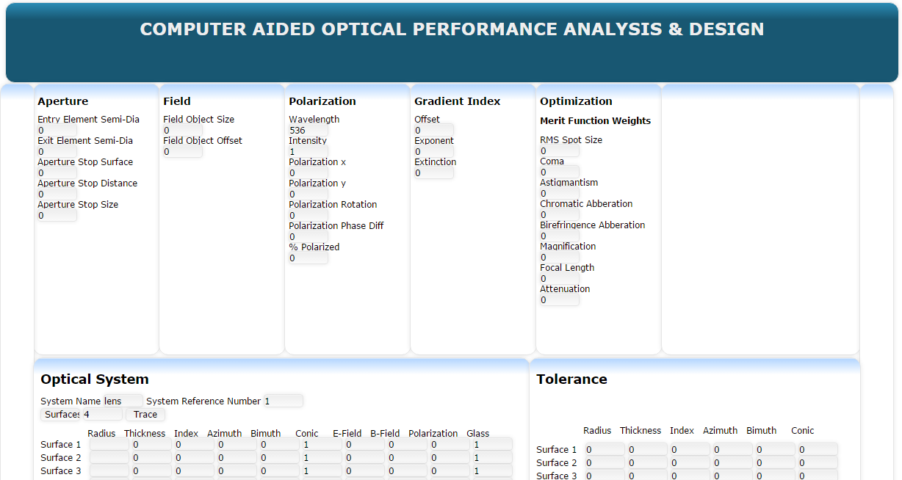
Intoduction to CAOPAD
Screen shot of the user interface

Slide 5
Paraxial Design
The paraxial design is the first phase of design & analysis using this tool.
The most basic of the system parameters such as the F/# are specified.
The system parameters such as the lens dimensions, orientations and glasses are entered into the interface.
The algorithm does a paraxial trace to determine the basic performance metrics.
Gives an overall idea of about how the system performs.
Also includes a solve.
Notes:
Healthcare policies may influence medical equipment requirements. Subsidized healthcare may warrant development of cheaper medical equipment for diagnosis of illnesses typically found in low income demographics. This may warrant a new market of image processsing algorithms that MedPhotonics aspires to get into.
A Linac is a medical equipment used for cancer diagnosis and treatment

Slide 6
Performance Evaluation
This is the second phase for optical design & analysis.
It picks up from the paraxial design phase and puts out more detailed performance parameters.
Different kinds of aberrations of the system are analyzed here.
Does a meridional trace as well as some basic non-sequential trace.
Gives a more accurate idea about how the system performs.
Notes:
Business Intelligence unis will help identify the new markets that the R & D might focus on

Slide 7
Optimization
This is final phase of design and analysis.
A merit function that adds all the performance parameters as operands with weights.
The tolerance of each system parameter is simultaneously specified.
The tolerance can either act as max variation from manufacturing or constraints for optimization.
The algorithm then minimizes the merit function gives the best performance with given constraints.
Gives a more refined system for the desired specifications.

Slide 8
Advantages of Simulated Annealing
The app uses R for running the algorithms
The UI uses javascript at Tibco as middleware
The optimization algorithm uses simulated annealing.
Most optimization algorithms settle down in local minimum.
Simulated Annealing is useful for finding the global minimum.
Notes:
The applications that have won the tenders for performing the business processes are as follows:
App1: Salesforce
App2: Oracle CRM
App3: Salesforce
App4: Oracle SCM
App5: Oracle Hyperion
App6: IBM Kanexa
App7: Oracle peoplesoft
App8: Tibco BW
App9: Longview Tax solutions
App10: Clearwater Compliance
App11: Tibco Spotfire
App12: MS Project
App13: IBM inventory management
App14: MS Visual studio
App15: Zemax Opticstudio & Solidworks
The IT infrastructure budget distribution is as follows:
The customer, investor relations, Business intelligence units will use the latest wireless and mobile infrastructure. Supply chain, finance, human resources, middleware will be given less preference on the IT infrastructure. Whatever that is left on the IT budget will go to the R & D IT infrastructure.
The IT application development will follow the reverse trend:
R & D will get the maximum budget for development life cycle of its applications, especially Zemax & Solidworks enabling maximum customization and support. The second preference will be given to Business Intelligence for it's Tibco Spotfire with latest versioning but minimal customiztion. The rest of the applications are all off-the-shelf and the versioning depends on whatever is left in the IT SDLC budget.

Slide 9
Comparison with Zemax
The optimization algorithm in Zemax uses damped least squares & orthogonal decent.
These algorithms tend to go to the nearest minimum and call it the solution.
Simulated annealing doesn’t get satisfied and keeps looking.
Simulated annealing arrives at a minimum that is global.
Notes:
The applications that have won the tenders for performing the business processes are as follows:
App1: Salesforce
App2: Oracle CRM
App3: Salesforce
App4: Oracle SCM
App5: Oracle Hyperion
App6: IBM Kanexa
App7: Oracle peoplesoft
App8: Tibco BW
App9: Longview Tax solutions
App10: Clearwater Compliance
App11: Tibco Spotfire
App12: MS Project
App13: IBM inventory management
App14: MS Visual studio
App15: Zemax Opticstudio & Solidworks
The IT infrastructure budget distribution is as follows:
The customer, investor relations, Business intelligence units will use the latest wireless and mobile infrastructure. Supply chain, finance, human resources, middleware will be given less preference on the IT infrastructure. Whatever that is left on the IT budget will go to the R & D IT infrastructure.
The IT application development will follow the reverse trend:
R & D will get the maximum budget for development life cycle of its applications, especially Zemax & Solidworks enabling maximum customization and support. The second preference will be given to Business Intelligence for it's Tibco Spotfire with latest versioning but minimal customiztion. The rest of the applications are all off-the-shelf and the versioning depends on whatever is left in the IT SDLC budget.

Slide 10
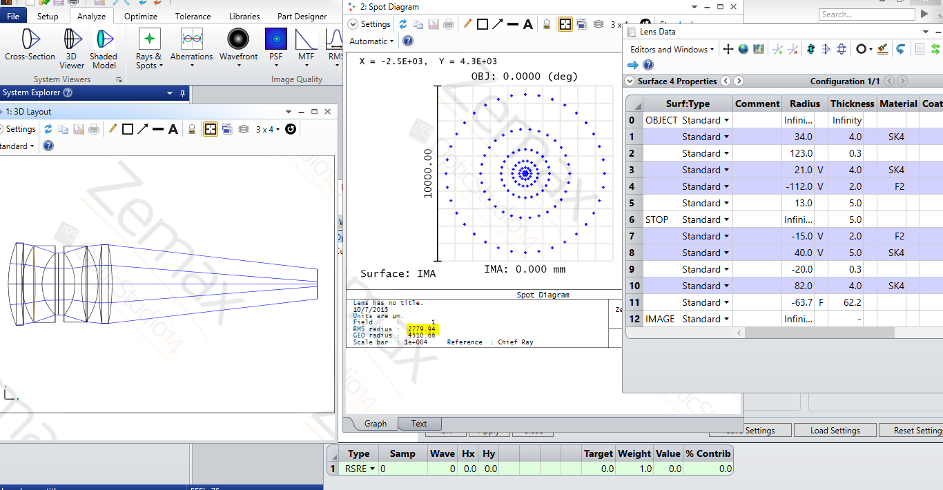
Comparison with Zemax
Screen shot of the RMS spot size of an optimized Double Gauss using zemax
Notes:
The applications that have won the tenders for performing the business processes are as follows:
App1: Salesforce
App2: Oracle CRM
App3: Salesforce
App4: Oracle SCM
App5: Oracle Hyperion
App6: IBM Kanexa
App7: Oracle peoplesoft
App8: Tibco BW
App9: Longview Tax solutions
App10: Clearwater Compliance
App11: Tibco Spotfire
App12: MS Project
App13: IBM inventory management
App14: MS Visual studio
App15: Zemax Opticstudio & Solidworks
The IT infrastructure budget distribution is as follows:
The customer, investor relations, Business intelligence units will use the latest wireless and mobile infrastructure. Supply chain, finance, human resources, middleware will be given less preference on the IT infrastructure. Whatever that is left on the IT budget will go to the R & D IT infrastructure.
The IT application development will follow the reverse trend:
R & D will get the maximum budget for development life cycle of its applications, especially Zemax & Solidworks enabling maximum customization and support. The second preference will be given to Business Intelligence for it's Tibco Spotfire with latest versioning but minimal customiztion. The rest of the applications are all off-the-shelf and the versioning depends on whatever is left in the IT SDLC budget.

Slide 11
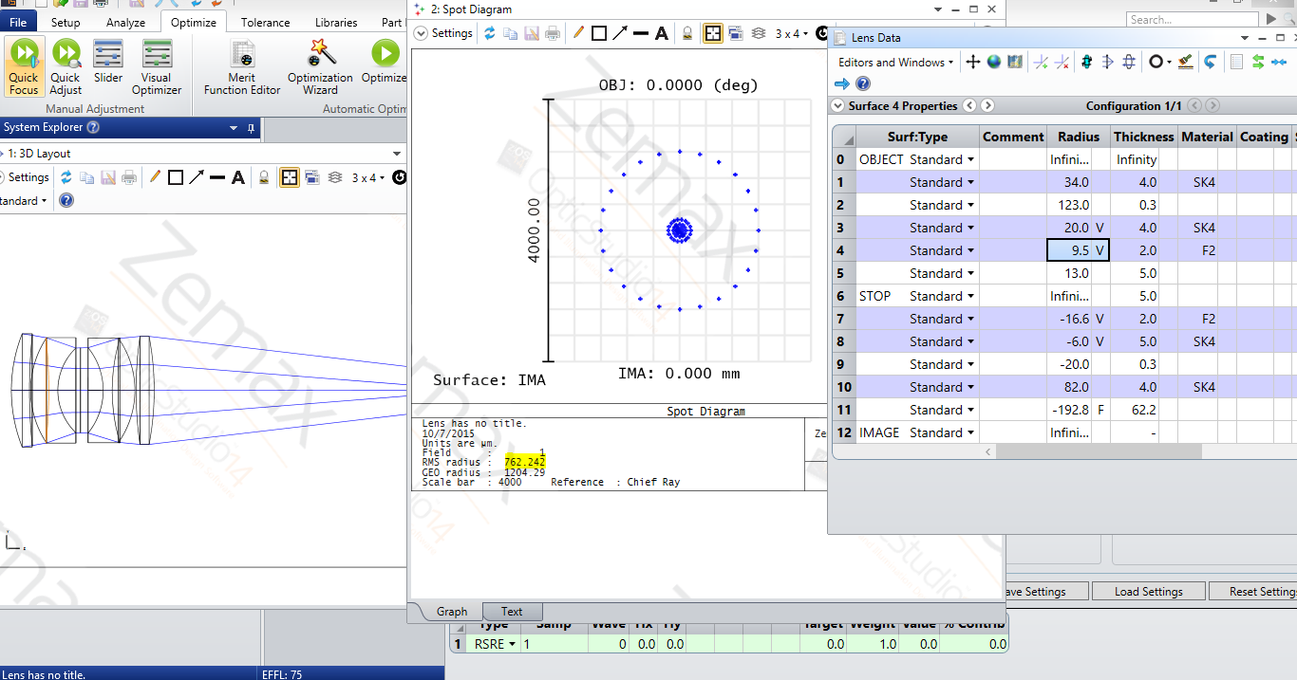
Comparison with Zemax
Screen shot of the RMS spot size of an optimized Double Gauss using zemax
Notes:
The applications that have won the tenders for performing the business processes are as follows:
App1: Salesforce
App2: Oracle CRM
App3: Salesforce
App4: Oracle SCM
App5: Oracle Hyperion
App6: IBM Kanexa
App7: Oracle peoplesoft
App8: Tibco BW
App9: Longview Tax solutions
App10: Clearwater Compliance
App11: Tibco Spotfire
App12: MS Project
App13: IBM inventory management
App14: MS Visual studio
App15: Zemax Opticstudio & Solidworks
The IT infrastructure budget distribution is as follows:
The customer, investor relations, Business intelligence units will use the latest wireless and mobile infrastructure. Supply chain, finance, human resources, middleware will be given less preference on the IT infrastructure. Whatever that is left on the IT budget will go to the R & D IT infrastructure.
The IT application development will follow the reverse trend:
R & D will get the maximum budget for development life cycle of its applications, especially Zemax & Solidworks enabling maximum customization and support. The second preference will be given to Business Intelligence for it's Tibco Spotfire with latest versioning but minimal customiztion. The rest of the applications are all off-the-shelf and the versioning depends on whatever is left in the IT SDLC budget.

Slide 12
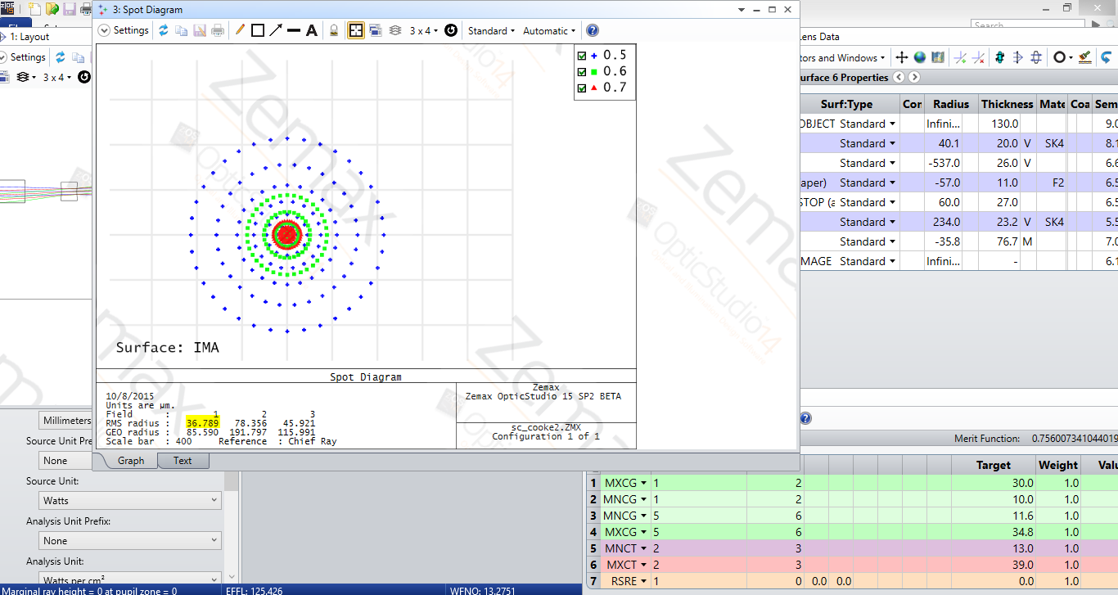
Comparison with Zemax
Screen shot of the RMS spot size of an optimized Cooke Triplet using zemax
Notes:
The applications that have won the tenders for performing the business processes are as follows:
App1: Salesforce
App2: Oracle CRM
App3: Salesforce
App4: Oracle SCM
App5: Oracle Hyperion
App6: IBM Kanexa
App7: Oracle peoplesoft
App8: Tibco BW
App9: Longview Tax solutions
App10: Clearwater Compliance
App11: Tibco Spotfire
App12: MS Project
App13: IBM inventory management
App14: MS Visual studio
App15: Zemax Opticstudio & Solidworks
The IT infrastructure budget distribution is as follows:
The customer, investor relations, Business intelligence units will use the latest wireless and mobile infrastructure. Supply chain, finance, human resources, middleware will be given less preference on the IT infrastructure. Whatever that is left on the IT budget will go to the R & D IT infrastructure.
The IT application development will follow the reverse trend:
R & D will get the maximum budget for development life cycle of its applications, especially Zemax & Solidworks enabling maximum customization and support. The second preference will be given to Business Intelligence for it's Tibco Spotfire with latest versioning but minimal customiztion. The rest of the applications are all off-the-shelf and the versioning depends on whatever is left in the IT SDLC budget.

Slide 13
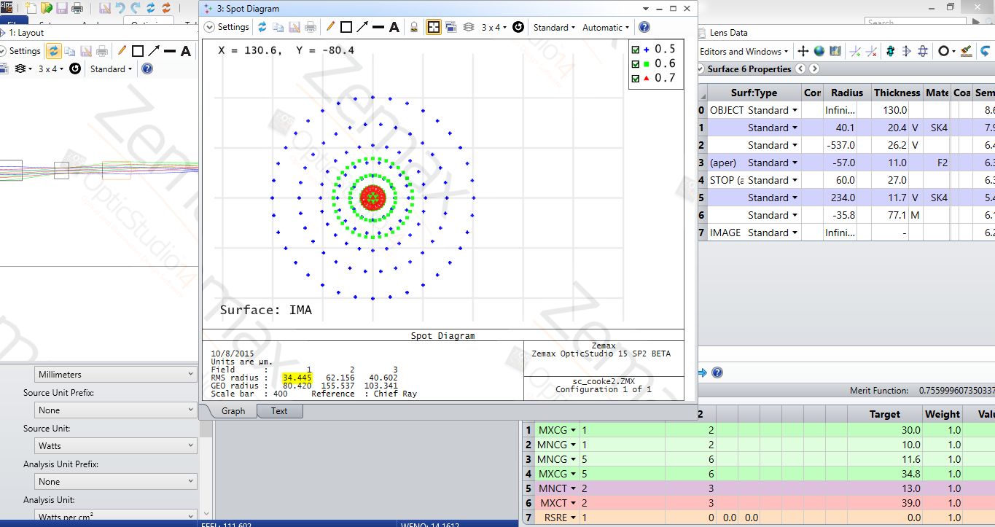
Comparison with Zemax
Screen shot of the RMS spot size of an optimized Cooke Triplet using zemax
Notes:
The applications that have won the tenders for performing the business processes are as follows:
App1: Salesforce
App2: Oracle CRM
App3: Salesforce
App4: Oracle SCM
App5: Oracle Hyperion
App6: IBM Kanexa
App7: Oracle peoplesoft
App8: Tibco BW
App9: Longview Tax solutions
App10: Clearwater Compliance
App11: Tibco Spotfire
App12: MS Project
App13: IBM inventory management
App14: MS Visual studio
App15: Zemax Opticstudio & Solidworks
The IT infrastructure budget distribution is as follows:
The customer, investor relations, Business intelligence units will use the latest wireless and mobile infrastructure. Supply chain, finance, human resources, middleware will be given less preference on the IT infrastructure. Whatever that is left on the IT budget will go to the R & D IT infrastructure.
The IT application development will follow the reverse trend:
R & D will get the maximum budget for development life cycle of its applications, especially Zemax & Solidworks enabling maximum customization and support. The second preference will be given to Business Intelligence for it's Tibco Spotfire with latest versioning but minimal customiztion. The rest of the applications are all off-the-shelf and the versioning depends on whatever is left in the IT SDLC budget.

Slide 14
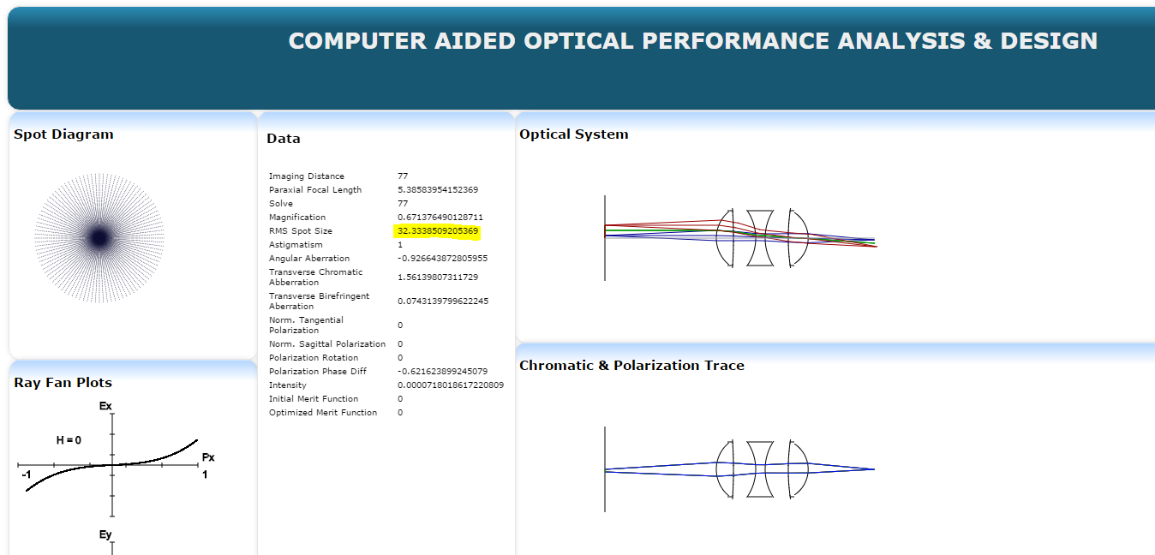
Comparison with Zemax
The same parameters are entered into the CAOPAD with same variables as constraints.
Notes:
The applications that have won the tenders for performing the business processes are as follows:
App1: Salesforce
App2: Oracle CRM
App3: Salesforce
App4: Oracle SCM
App5: Oracle Hyperion
App6: IBM Kanexa
App7: Oracle peoplesoft
App8: Tibco BW
App9: Longview Tax solutions
App10: Clearwater Compliance
App11: Tibco Spotfire
App12: MS Project
App13: IBM inventory management
App14: MS Visual studio
App15: Zemax Opticstudio & Solidworks
The IT infrastructure budget distribution is as follows:
The customer, investor relations, Business intelligence units will use the latest wireless and mobile infrastructure. Supply chain, finance, human resources, middleware will be given less preference on the IT infrastructure. Whatever that is left on the IT budget will go to the R & D IT infrastructure.
The IT application development will follow the reverse trend:
R & D will get the maximum budget for development life cycle of its applications, especially Zemax & Solidworks enabling maximum customization and support. The second preference will be given to Business Intelligence for it's Tibco Spotfire with latest versioning but minimal customiztion. The rest of the applications are all off-the-shelf and the versioning depends on whatever is left in the IT SDLC budget.

Slide 15
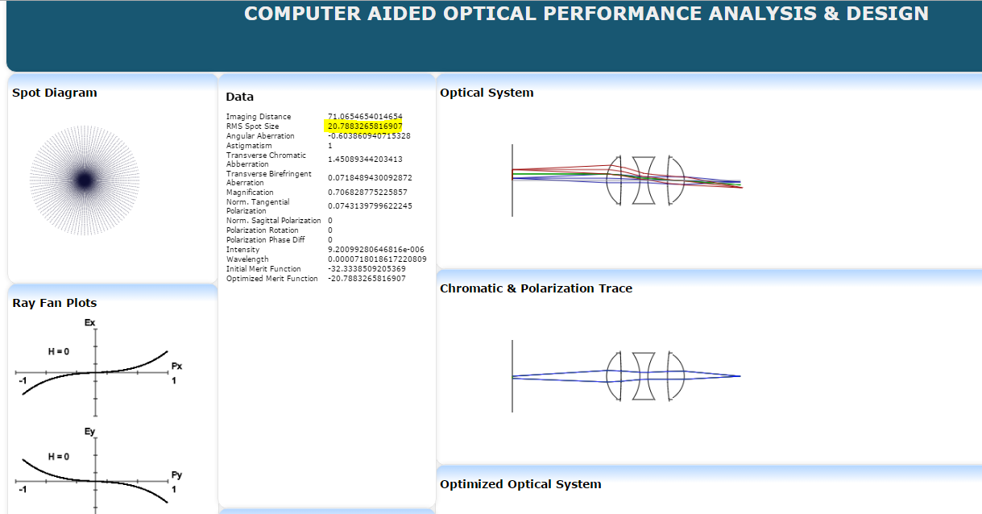
Comparison with Zemax
The same parameters are entered into the CAOPAD after optimization.
Notes:
The applications that have won the tenders for performing the business processes are as follows:
App1: Salesforce
App2: Oracle CRM
App3: Salesforce
App4: Oracle SCM
App5: Oracle Hyperion
App6: IBM Kanexa
App7: Oracle peoplesoft
App8: Tibco BW
App9: Longview Tax solutions
App10: Clearwater Compliance
App11: Tibco Spotfire
App12: MS Project
App13: IBM inventory management
App14: MS Visual studio
App15: Zemax Opticstudio & Solidworks
The IT infrastructure budget distribution is as follows:
The customer, investor relations, Business intelligence units will use the latest wireless and mobile infrastructure. Supply chain, finance, human resources, middleware will be given less preference on the IT infrastructure. Whatever that is left on the IT budget will go to the R & D IT infrastructure.
The IT application development will follow the reverse trend:
R & D will get the maximum budget for development life cycle of its applications, especially Zemax & Solidworks enabling maximum customization and support. The second preference will be given to Business Intelligence for it's Tibco Spotfire with latest versioning but minimal customiztion. The rest of the applications are all off-the-shelf and the versioning depends on whatever is left in the IT SDLC budget.

Slide 16
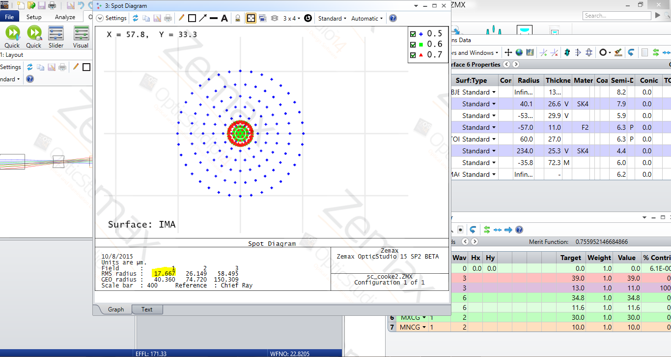
Comparison with Zemax
Screen shot of the RMS spot size of an optimized Cooke Triplet using zemax
Notes:
The applications that have won the tenders for performing the business processes are as follows:
App1: Salesforce
App2: Oracle CRM
App3: Salesforce
App4: Oracle SCM
App5: Oracle Hyperion
App6: IBM Kanexa
App7: Oracle peoplesoft
App8: Tibco BW
App9: Longview Tax solutions
App10: Clearwater Compliance
App11: Tibco Spotfire
App12: MS Project
App13: IBM inventory management
App14: MS Visual studio
App15: Zemax Opticstudio & Solidworks
The IT infrastructure budget distribution is as follows:
The customer, investor relations, Business intelligence units will use the latest wireless and mobile infrastructure. Supply chain, finance, human resources, middleware will be given less preference on the IT infrastructure. Whatever that is left on the IT budget will go to the R & D IT infrastructure.
The IT application development will follow the reverse trend:
R & D will get the maximum budget for development life cycle of its applications, especially Zemax & Solidworks enabling maximum customization and support. The second preference will be given to Business Intelligence for it's Tibco Spotfire with latest versioning but minimal customiztion. The rest of the applications are all off-the-shelf and the versioning depends on whatever is left in the IT SDLC budget.

Slide 17
Comparison with Zemax
For the same system, merit function and variables or constraints,
The CAOPAD was able to find a configuration with a smaller RMS spot size that with Zemax.
This is because Simulated Annealing was able to persist to global minimum.
Systems with better imaging can be designed using this type of optimization.
Notes:
The applications that have won the tenders for performing the business processes are as follows:
App1: Salesforce
App2: Oracle CRM
App3: Salesforce
App4: Oracle SCM
App5: Oracle Hyperion
App6: IBM Kanexa
App7: Oracle peoplesoft
App8: Tibco BW
App9: Longview Tax solutions
App10: Clearwater Compliance
App11: Tibco Spotfire
App12: MS Project
App13: IBM inventory management
App14: MS Visual studio
App15: Zemax Opticstudio & Solidworks
The IT infrastructure budget distribution is as follows:
The customer, investor relations, Business intelligence units will use the latest wireless and mobile infrastructure. Supply chain, finance, human resources, middleware will be given less preference on the IT infrastructure. Whatever that is left on the IT budget will go to the R & D IT infrastructure.
The IT application development will follow the reverse trend:
R & D will get the maximum budget for development life cycle of its applications, especially Zemax & Solidworks enabling maximum customization and support. The second preference will be given to Business Intelligence for it's Tibco Spotfire with latest versioning but minimal customiztion. The rest of the applications are all off-the-shelf and the versioning depends on whatever is left in the IT SDLC budget.

Slide 18
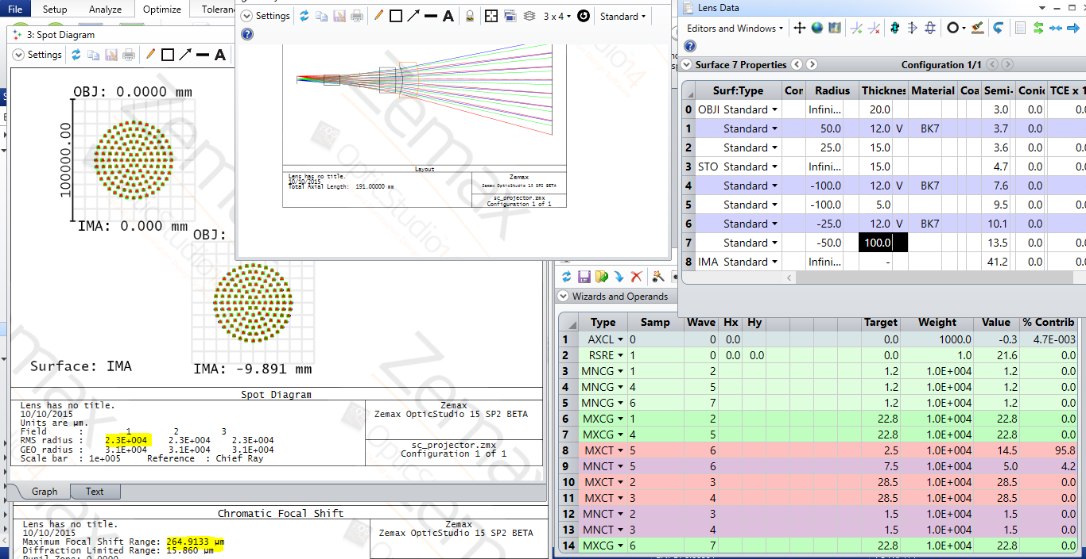
Applications
Shown is the designing a Projector using CAOPAD. – original
Notes:
The applications that have won the tenders for performing the business processes are as follows:
App1: Salesforce
App2: Oracle CRM
App3: Salesforce
App4: Oracle SCM
App5: Oracle Hyperion
App6: IBM Kanexa
App7: Oracle peoplesoft
App8: Tibco BW
App9: Longview Tax solutions
App10: Clearwater Compliance
App11: Tibco Spotfire
App12: MS Project
App13: IBM inventory management
App14: MS Visual studio
App15: Zemax Opticstudio & Solidworks
The IT infrastructure budget distribution is as follows:
The customer, investor relations, Business intelligence units will use the latest wireless and mobile infrastructure. Supply chain, finance, human resources, middleware will be given less preference on the IT infrastructure. Whatever that is left on the IT budget will go to the R & D IT infrastructure.
The IT application development will follow the reverse trend:
R & D will get the maximum budget for development life cycle of its applications, especially Zemax & Solidworks enabling maximum customization and support. The second preference will be given to Business Intelligence for it's Tibco Spotfire with latest versioning but minimal customiztion. The rest of the applications are all off-the-shelf and the versioning depends on whatever is left in the IT SDLC budget.

Slide 19
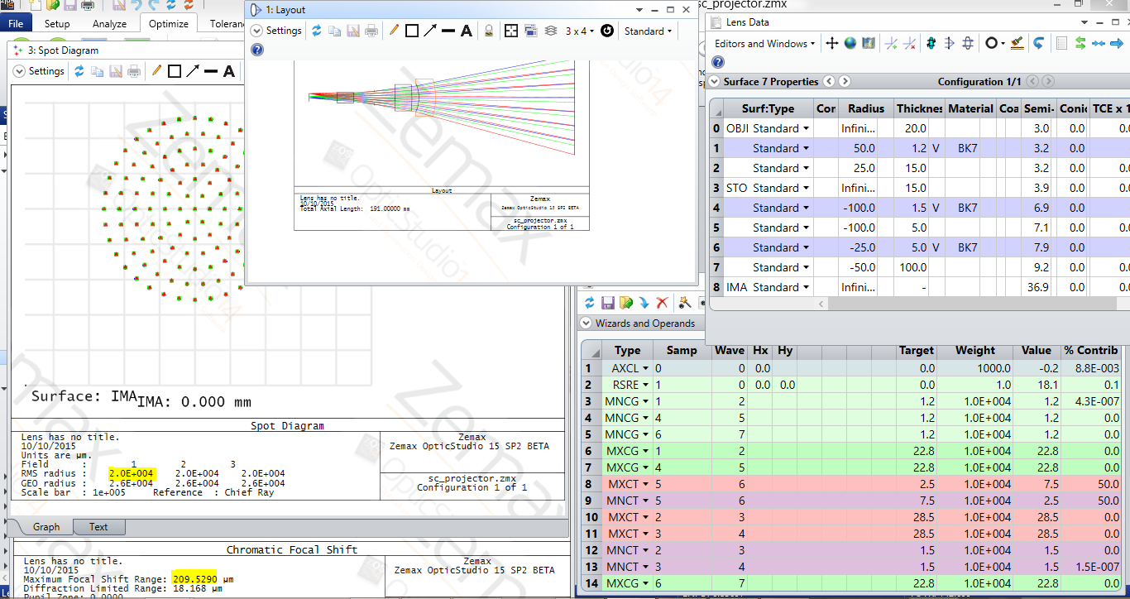
Applications
Shown is the designing a Projector using CAOPAD. – optimization using zemax
Notes:
The applications that have won the tenders for performing the business processes are as follows:
App1: Salesforce
App2: Oracle CRM
App3: Salesforce
App4: Oracle SCM
App5: Oracle Hyperion
App6: IBM Kanexa
App7: Oracle peoplesoft
App8: Tibco BW
App9: Longview Tax solutions
App10: Clearwater Compliance
App11: Tibco Spotfire
App12: MS Project
App13: IBM inventory management
App14: MS Visual studio
App15: Zemax Opticstudio & Solidworks
The IT infrastructure budget distribution is as follows:
The customer, investor relations, Business intelligence units will use the latest wireless and mobile infrastructure. Supply chain, finance, human resources, middleware will be given less preference on the IT infrastructure. Whatever that is left on the IT budget will go to the R & D IT infrastructure.
The IT application development will follow the reverse trend:
R & D will get the maximum budget for development life cycle of its applications, especially Zemax & Solidworks enabling maximum customization and support. The second preference will be given to Business Intelligence for it's Tibco Spotfire with latest versioning but minimal customiztion. The rest of the applications are all off-the-shelf and the versioning depends on whatever is left in the IT SDLC budget.

Slide 20
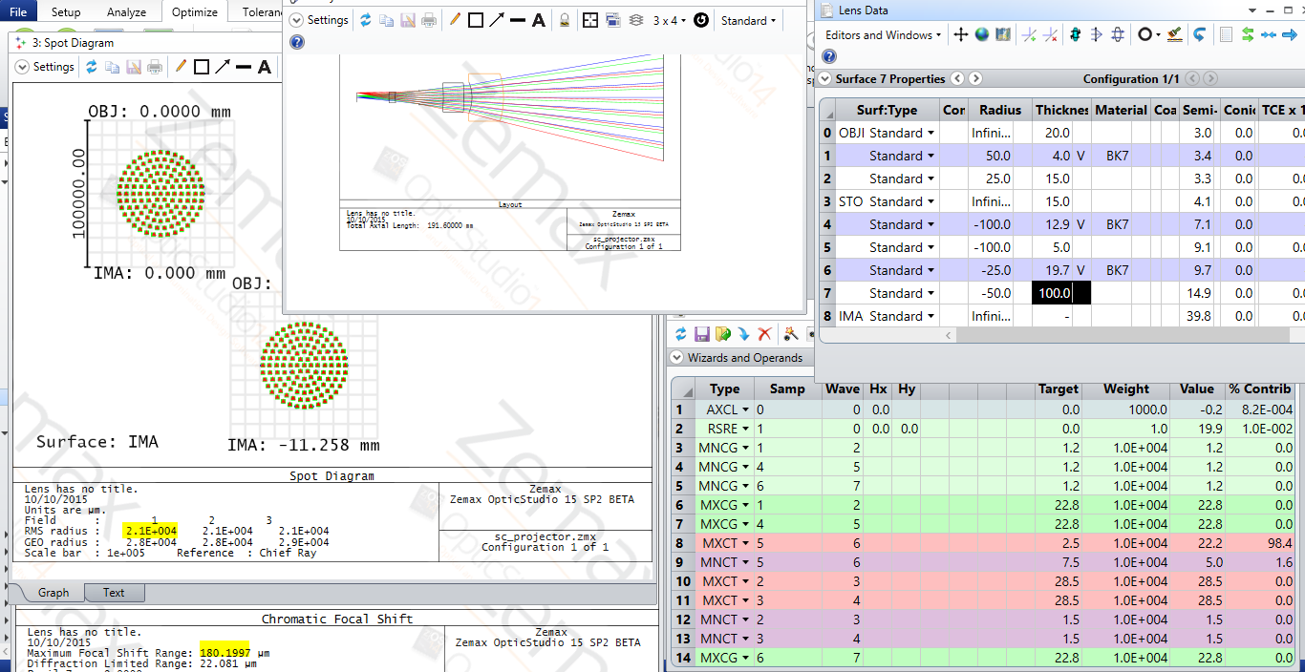
Applications
Shown is the designing a Projector using CAOPAD. Optimization using CAOPAD, in zemax
Notes:
The applications that have won the tenders for performing the business processes are as follows:
App1: Salesforce
App2: Oracle CRM
App3: Salesforce
App4: Oracle SCM
App5: Oracle Hyperion
App6: IBM Kanexa
App7: Oracle peoplesoft
App8: Tibco BW
App9: Longview Tax solutions
App10: Clearwater Compliance
App11: Tibco Spotfire
App12: MS Project
App13: IBM inventory management
App14: MS Visual studio
App15: Zemax Opticstudio & Solidworks
The IT infrastructure budget distribution is as follows:
The customer, investor relations, Business intelligence units will use the latest wireless and mobile infrastructure. Supply chain, finance, human resources, middleware will be given less preference on the IT infrastructure. Whatever that is left on the IT budget will go to the R & D IT infrastructure.
The IT application development will follow the reverse trend:
R & D will get the maximum budget for development life cycle of its applications, especially Zemax & Solidworks enabling maximum customization and support. The second preference will be given to Business Intelligence for it's Tibco Spotfire with latest versioning but minimal customiztion. The rest of the applications are all off-the-shelf and the versioning depends on whatever is left in the IT SDLC budget.

Slide 21
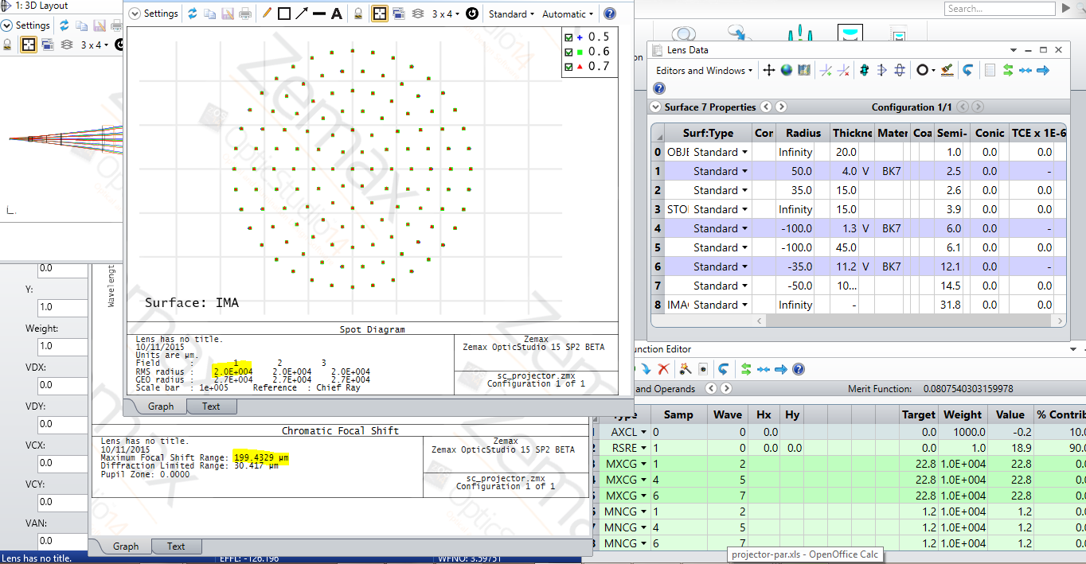
Applications
Shown is the designing a Projector using CAOPAD. Optimization using CAOPAD, in zemax
Notes:
The applications that have won the tenders for performing the business processes are as follows:
App1: Salesforce
App2: Oracle CRM
App3: Salesforce
App4: Oracle SCM
App5: Oracle Hyperion
App6: IBM Kanexa
App7: Oracle peoplesoft
App8: Tibco BW
App9: Longview Tax solutions
App10: Clearwater Compliance
App11: Tibco Spotfire
App12: MS Project
App13: IBM inventory management
App14: MS Visual studio
App15: Zemax Opticstudio & Solidworks
The IT infrastructure budget distribution is as follows:
The customer, investor relations, Business intelligence units will use the latest wireless and mobile infrastructure. Supply chain, finance, human resources, middleware will be given less preference on the IT infrastructure. Whatever that is left on the IT budget will go to the R & D IT infrastructure.
The IT application development will follow the reverse trend:
R & D will get the maximum budget for development life cycle of its applications, especially Zemax & Solidworks enabling maximum customization and support. The second preference will be given to Business Intelligence for it's Tibco Spotfire with latest versioning but minimal customiztion. The rest of the applications are all off-the-shelf and the versioning depends on whatever is left in the IT SDLC budget.

Slide 22
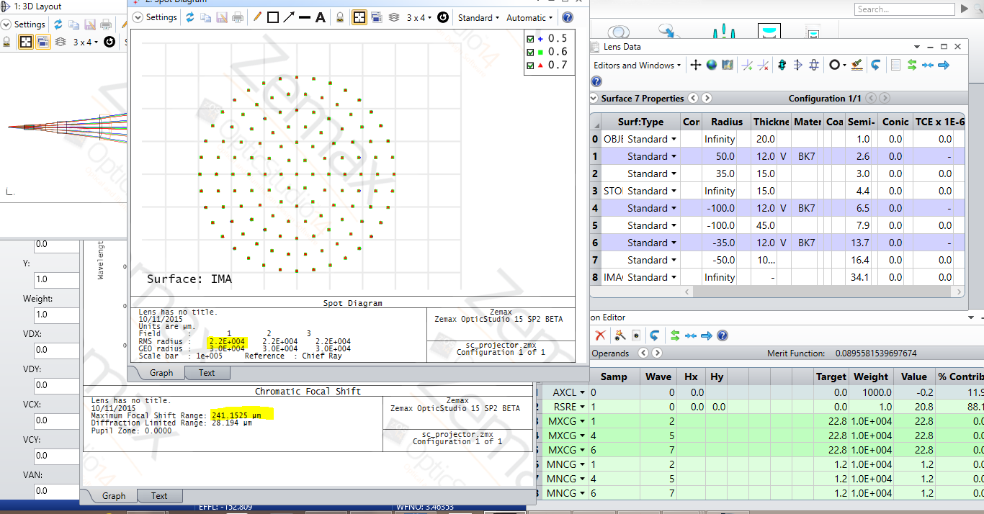
Applications
Shown is the designing a Projector using CAOPAD. Optimization using CAOPAD, in zemax
Notes:
The applications that have won the tenders for performing the business processes are as follows:
App1: Salesforce
App2: Oracle CRM
App3: Salesforce
App4: Oracle SCM
App5: Oracle Hyperion
App6: IBM Kanexa
App7: Oracle peoplesoft
App8: Tibco BW
App9: Longview Tax solutions
App10: Clearwater Compliance
App11: Tibco Spotfire
App12: MS Project
App13: IBM inventory management
App14: MS Visual studio
App15: Zemax Opticstudio & Solidworks
The IT infrastructure budget distribution is as follows:
The customer, investor relations, Business intelligence units will use the latest wireless and mobile infrastructure. Supply chain, finance, human resources, middleware will be given less preference on the IT infrastructure. Whatever that is left on the IT budget will go to the R & D IT infrastructure.
The IT application development will follow the reverse trend:
R & D will get the maximum budget for development life cycle of its applications, especially Zemax & Solidworks enabling maximum customization and support. The second preference will be given to Business Intelligence for it's Tibco Spotfire with latest versioning but minimal customiztion. The rest of the applications are all off-the-shelf and the versioning depends on whatever is left in the IT SDLC budget.

Slide 23
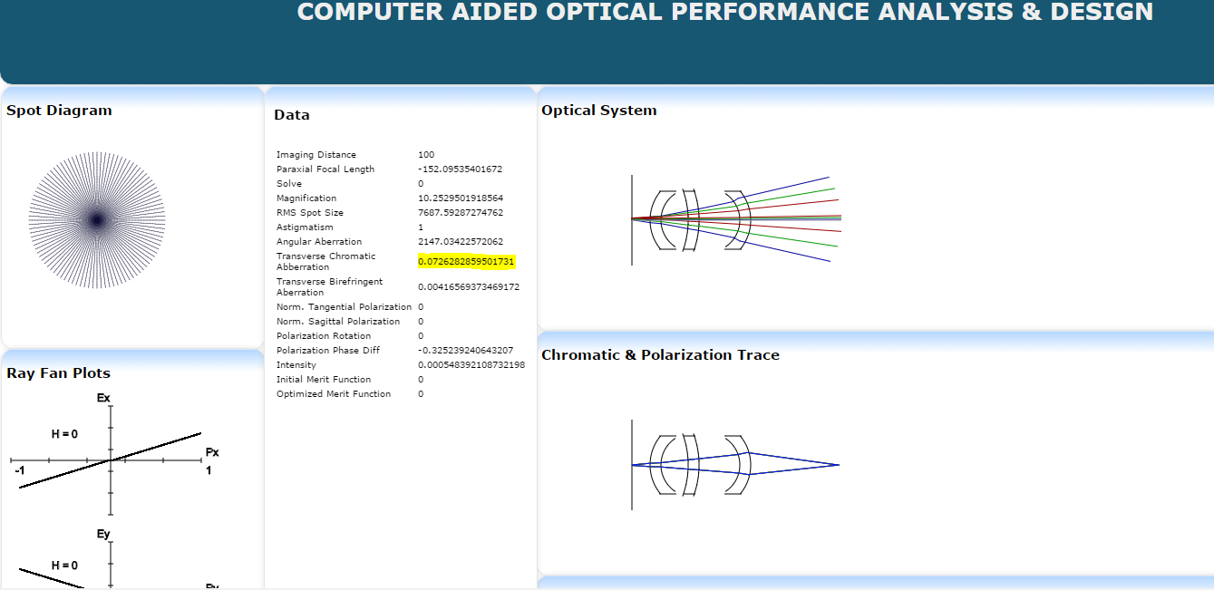
Applications
Shown is the designing a Projector using CAOPAD. Optimization using CAOPAD, in zemax
Notes:
The applications that have won the tenders for performing the business processes are as follows:
App1: Salesforce
App2: Oracle CRM
App3: Salesforce
App4: Oracle SCM
App5: Oracle Hyperion
App6: IBM Kanexa
App7: Oracle peoplesoft
App8: Tibco BW
App9: Longview Tax solutions
App10: Clearwater Compliance
App11: Tibco Spotfire
App12: MS Project
App13: IBM inventory management
App14: MS Visual studio
App15: Zemax Opticstudio & Solidworks
The IT infrastructure budget distribution is as follows:
The customer, investor relations, Business intelligence units will use the latest wireless and mobile infrastructure. Supply chain, finance, human resources, middleware will be given less preference on the IT infrastructure. Whatever that is left on the IT budget will go to the R & D IT infrastructure.
The IT application development will follow the reverse trend:
R & D will get the maximum budget for development life cycle of its applications, especially Zemax & Solidworks enabling maximum customization and support. The second preference will be given to Business Intelligence for it's Tibco Spotfire with latest versioning but minimal customiztion. The rest of the applications are all off-the-shelf and the versioning depends on whatever is left in the IT SDLC budget.

Slide 24
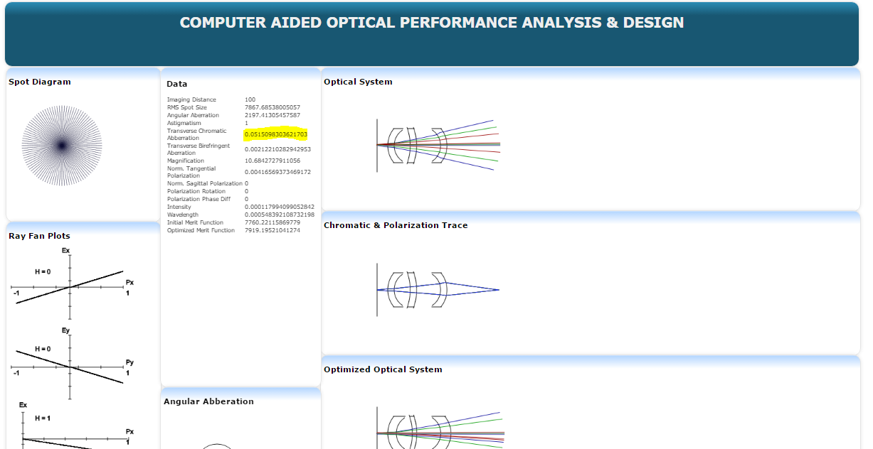
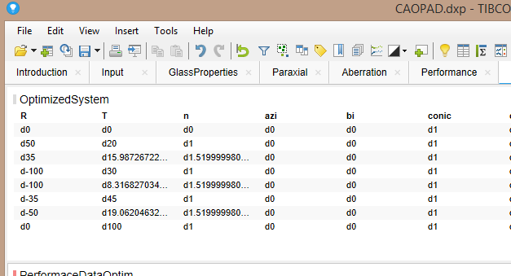
Applications
Shown is the designing a Projector using CAOPAD. Optimization using CAOPAD, in zemax
Notes:
The applications that have won the tenders for performing the business processes are as follows:
App1: Salesforce
App2: Oracle CRM
App3: Salesforce
App4: Oracle SCM
App5: Oracle Hyperion
App6: IBM Kanexa
App7: Oracle peoplesoft
App8: Tibco BW
App9: Longview Tax solutions
App10: Clearwater Compliance
App11: Tibco Spotfire
App12: MS Project
App13: IBM inventory management
App14: MS Visual studio
App15: Zemax Opticstudio & Solidworks
The IT infrastructure budget distribution is as follows:
The customer, investor relations, Business intelligence units will use the latest wireless and mobile infrastructure. Supply chain, finance, human resources, middleware will be given less preference on the IT infrastructure. Whatever that is left on the IT budget will go to the R & D IT infrastructure.
The IT application development will follow the reverse trend:
R & D will get the maximum budget for development life cycle of its applications, especially Zemax & Solidworks enabling maximum customization and support. The second preference will be given to Business Intelligence for it's Tibco Spotfire with latest versioning but minimal customiztion. The rest of the applications are all off-the-shelf and the versioning depends on whatever is left in the IT SDLC budget.

Slide 25
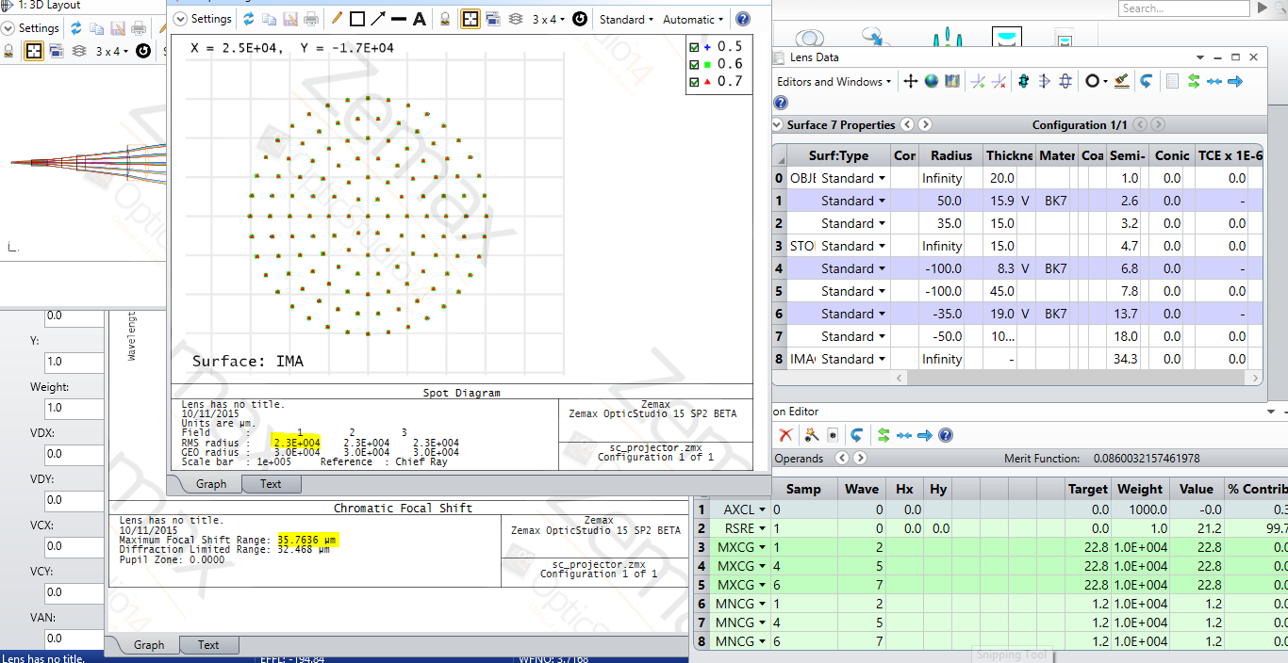
Applications
Shown is the designing a Projector using CAOPAD. Optimization using CAOPAD, in zemax
Notes:
The applications that have won the tenders for performing the business processes are as follows:
App1: Salesforce
App2: Oracle CRM
App3: Salesforce
App4: Oracle SCM
App5: Oracle Hyperion
App6: IBM Kanexa
App7: Oracle peoplesoft
App8: Tibco BW
App9: Longview Tax solutions
App10: Clearwater Compliance
App11: Tibco Spotfire
App12: MS Project
App13: IBM inventory management
App14: MS Visual studio
App15: Zemax Opticstudio & Solidworks
The IT infrastructure budget distribution is as follows:
The customer, investor relations, Business intelligence units will use the latest wireless and mobile infrastructure. Supply chain, finance, human resources, middleware will be given less preference on the IT infrastructure. Whatever that is left on the IT budget will go to the R & D IT infrastructure.
The IT application development will follow the reverse trend:
R & D will get the maximum budget for development life cycle of its applications, especially Zemax & Solidworks enabling maximum customization and support. The second preference will be given to Business Intelligence for it's Tibco Spotfire with latest versioning but minimal customiztion. The rest of the applications are all off-the-shelf and the versioning depends on whatever is left in the IT SDLC budget.

Slide 26
Future Work
More features to match that of Zemax.
Web hosting.
Expand non-sequential tracing.
Further improve optimization.
Notes:
The applications that have won the tenders for performing the business processes are as follows:
App1: Salesforce
App2: Oracle CRM
App3: Salesforce
App4: Oracle SCM
App5: Oracle Hyperion
App6: IBM Kanexa
App7: Oracle peoplesoft
App8: Tibco BW
App9: Longview Tax solutions
App10: Clearwater Compliance
App11: Tibco Spotfire
App12: MS Project
App13: IBM inventory management
App14: MS Visual studio
App15: Zemax Opticstudio & Solidworks
The IT infrastructure budget distribution is as follows:
The customer, investor relations, Business intelligence units will use the latest wireless and mobile infrastructure. Supply chain, finance, human resources, middleware will be given less preference on the IT infrastructure. Whatever that is left on the IT budget will go to the R & D IT infrastructure.
The IT application development will follow the reverse trend:
R & D will get the maximum budget for development life cycle of its applications, especially Zemax & Solidworks enabling maximum customization and support. The second preference will be given to Business Intelligence for it's Tibco Spotfire with latest versioning but minimal customiztion. The rest of the applications are all off-the-shelf and the versioning depends on whatever is left in the IT SDLC budget.

Slide 27
Conclusion
The CAOPAD is able to optimize better than Zemax.
Certain systems such as a lithography lens, projector were designed using CAOPAD.
More expansion is on the way for CAOPAD.

Slide 28
Thank You
Questions?

